Slide 1

Pivot Tables
BI Practical # 4
Subject Teachers: Sanjeela Sagar & Hrishikesh Tendulkar

Slide 2
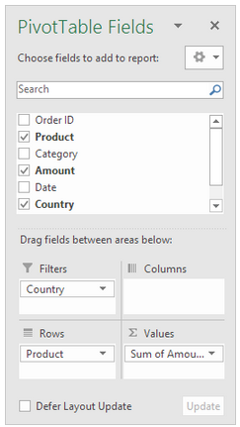
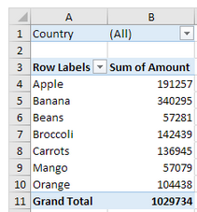
Pivot Tables (Insert a Pivot Table)
To insert a pivot table, execute the following steps.
Click any single cell inside the data set.
On the Insert tab, in the Tables group, click PivotTable.
The following dialog box appears. Excel automatically selects the data for you. The default location for a new pivot table is New Worksheet.
Click OK.
Drag fields
The PivotTable Fields pane appears. To get the total amount exported of each product, drag the following fields to the different areas.
Product field to the Rows area.
Amount field to the Values area.
Country field to the Filters area.
Bananas are our main export product.

Slide 3
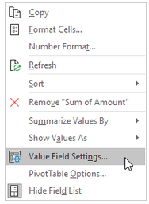
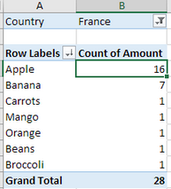
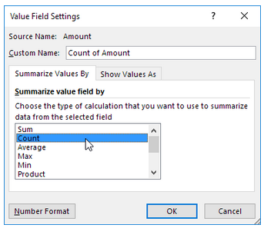
Pivot Table (Change Summary Calculation)
To change the type of calculation that you want to use, execute the following steps.
Click any cell inside the Sum of Amount column.
Right click and click on Value Field Settings.
Choose the type of calculation you want to use. For example, click Count.
Click OK.
Result. 16 out of the 28 orders to France were 'Apple' orders.

Slide 4

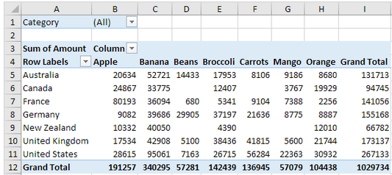
Pivot Table (Two-dimensional Pivot Table)
If you drag a field to the Rows area and Columns area, you can create a two-dimensional pivot table. First, insert a pivot table. Next, to get the total amount exported to each country, of each product, drag the following fields to the different areas.
Country field to the Rows area.
Product field to the Columns area.
Amount field to the Values area.
Category field to the Filters area.

Slide 5
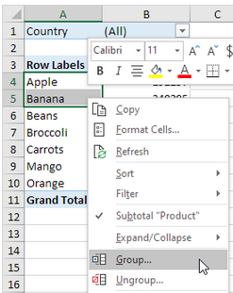
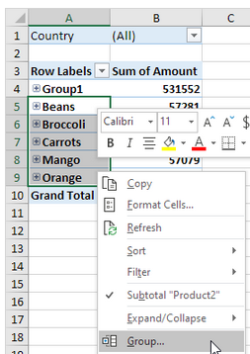
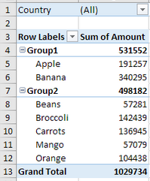
Pivot table (Group Pivot Table Items)
The Product field contains 7 items. Apple, Banana, Beans, Broccoli, Carrots, Mango and Orange.
To create two groups, execute the following steps.
In the pivot table, select Apple and Banana.
Right click and click on Group.
In the pivot table, select Beans, Broccoli, Carrots, Mango and Orange.
Right click and click on Group.
Conclusion: Apple and Banana (Group1) have a higher total than all the other products (Group2) together.

Slide 6
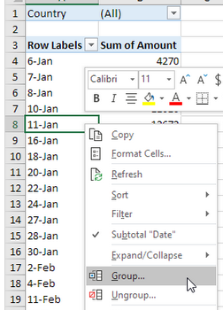
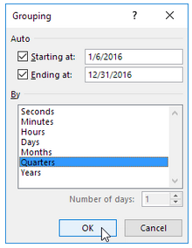
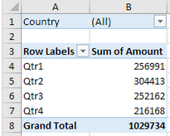
Pivot Table (Group Dates)
To create the pivot table below, instead of the Product field, add the Date field to the Rows area. The Date field contains many items. 6-Jan, 7-Jan, 8-Jan, 10-Jan, 11-Jan, etc.
To group these dates by quarters, execute the following steps.
Click any cell inside the column with dates.
Right click and click on Group.
Select Quarters and click OK.
Conclusion: Quarter 2 is the best quarter.

Slide 7
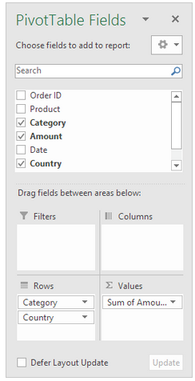
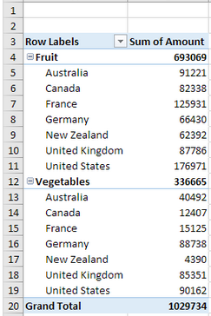
Pivot Table (Multi-level Pivot Table | Multiple Row Fields)
First, insert a pivot table. Next, drag the following fields to the different areas.
Category field and Country field to the Rows area.
Amount field to the Values area.

Slide 8
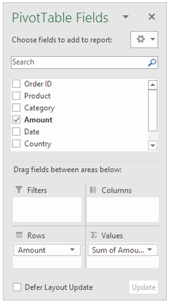
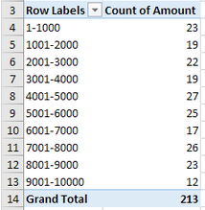
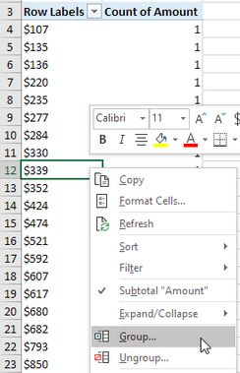
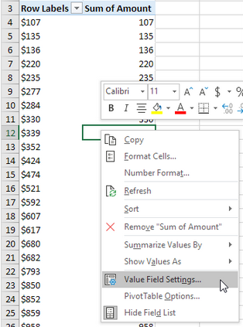
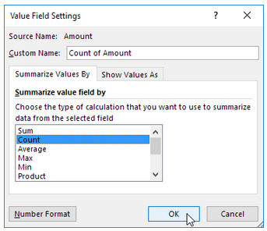
Pivot Table (Frequency Distribution)
First, insert a pivot table. Next, drag the following fields to the different areas.
Amount field to the Rows area.
Amount field (or any other field) to the Values area.
Click any cell inside the Sum of Amount column.
Right click and click on Value Field Settings.
Choose Count and click OK.
Next, click any cell inside the column with Row Labels.
Right click and click on Group.
Enter 1 for Starting at, 10000 for Ending at, and 1000 for By. Click OK.

Slide 9
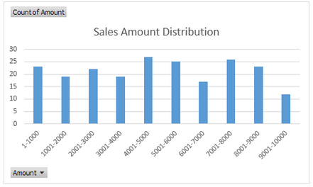

Pivot Table (Frequency Distribution)
To easily compare these numbers, create a pivot chart.
Click any cell inside the pivot table.
On the Analyze tab, in the Tools group, click PivotChart.
The Insert Chart dialog box appears. Click OK.

Slide 10
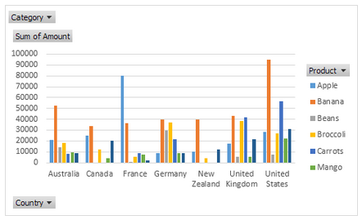

Pivot Table (Pivot Chart | Insert Pivot Chart)
To insert a pivot chart on 2 dimensional pivot table, execute the following steps.
Click any cell inside the pivot table.
On the Analyze tab, in the Tools group, click PivotChart.
The Insert Chart dialog box appears. Click OK.

Slide 11
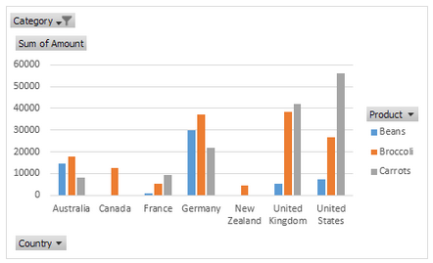
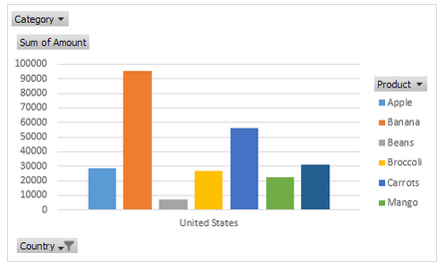
Pivot Table (Pivot Chart | Filter Pivot Chart)
To filter this pivot chart, execute the following steps.
Use the standard filters (triangles next to Product and Country). For example, use the Country filter to only show the total amount of each product exported to the United States.
Remove the Country filter.
Because we added the Category field to the Filters area, we can filter this pivot chart (and pivot table) by Category. For example, use the Category filter to only show the vegetables exported to each country.

Slide 12
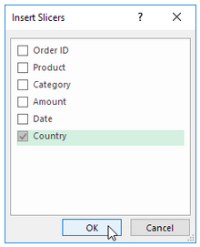
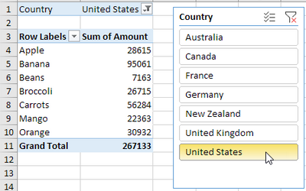
Pivot Table (Slicers)
To insert a slicer, execute the following steps.
Click any cell inside the pivot table.
On the Analyze tab, in the Filter group, click Insert Slicer.
Check Country and click OK.
Click United States to find out which products we export the most to the United States.
Conclusion: bananas are our main export product to the United States. The report filter (cell B1) changes to United States.

